Slide 1
Support Vector Machines
Course : COMP6065001 Artificial Intelligence
Effective Period : September 2023
Session 18

Slide 2
Learning Outcomes
At the end of this session, students will be able to:
LO 4: Apply various learning algorithms to solve the problems

Slide 3
Outline
SVM Optimization Problem
SVM Goal
Example
Exercise

Slide 4
Introduction
Before deep learning, support vector machine was the most popular approach for “off-the-shelf” supervised learning
Three properties that makes SVM attractive:
SVMs construct a maximum margin separator
SVMs create a linear separating hyperplane, but they have the ability to embed the data into a higher-dimensional space, using the so-called kernel trick
SVMs are a nonparametric method

Slide 5
SVM Optimization Problem
The main objective of SVM is finding optimal separating hyperplane. Which maximize margin from training data
To understand the objective, we prepared an example to identify male/female based on their height and weight
IF a person has 175 cm and weight 80 kg.
IS he or she?

Slide 6
SVM Goal
We need to develop a line which separate the data between male or female class.
Why the line called hyperplane?

Slide 7
SVM Goal
Hyperplane is the generalization of the plane
The 1 dimension, hyperplane = point
The 2-dimension, hyperplane = line
The 3-dimension, hyperplane = plane
More than 3-dimension, we call it hyperplane

Slide 8

Example
1-dimension hyperplane
Hyperplane

Slide 9
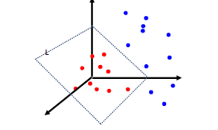
Example
3-dimension hyperplane
Hyperplane

Slide 10
What is the Optimal separating Hyperplane?
We could create many hyperplane in our data

Slide 11
What is the Optimal separating Hyperplane?
IF we choose the green line. The hyperplane is close to the female class data points.
In this case, we could not create a good generalized model.

Slide 12
What is the Optimal separating Hyperplane?
IF we choose the black line. The hyperplane is far from each class data points.
In this case, we could create a good generalized model.

Slide 13
What is the Optimal separating Hyperplane?
Calculate distance between hyperplane with the closest data point
Optimal hyperplane is the hyperplane which have bigger margin

Slide 14
Linear Classifier
The maximum margin linear classifier is linear classifier with maximum margin
Maximum margin classifier is the simple form of support vector machines (Linear SVM)
Support vector

Slide 15
How to find the biggest margin/ optimal hyperplane?
Sec. 15.1
Prepare the Dataset
Choose two hyperplanes which separate data
Maximize margin
Slide by C. Manning and P. Nayak

Slide 16


First Step: Dataset
Most of the data have n vector $x_{i}$
Each $x_{i}$ associate with $y_{i}$ with +1 and -1 as their class.

Slide 17
Step 2: Choose two hyperplanes which separate data

Slide 18
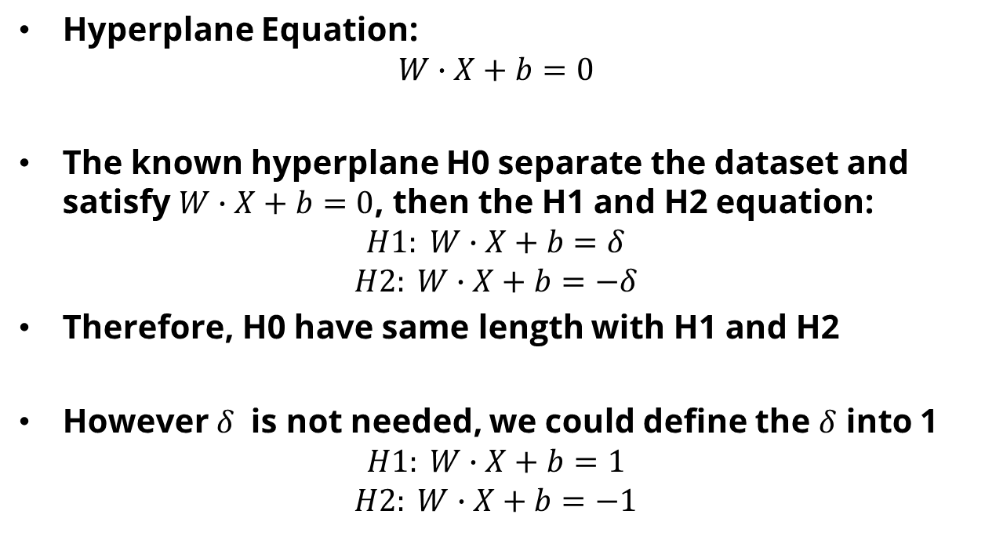
Step 2: Choose two hyperplanes which separate data
Hyperplane Equation:
$$W∙X+b=0$$
The known hyperplane H0 separate the dataset and satisfy $W∙X+b=0$, then the H1 and H2 equation:
$$H1: W∙X+b=δ$$
$$H2: W∙X+b=−δ$$
Therefore, H0 have same length with H1 and H2
However $δ$ is not needed, we could define the $δ$ into 1
$$H1: W∙X+b=1$$
$$H2: W∙X+b=−1$$

Slide 19
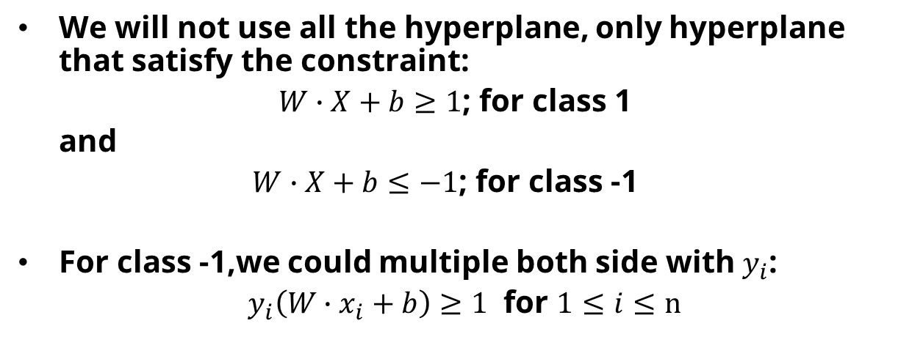
Step 2: Choose two hyperplanes which separate data
We will not use all the hyperplane, only hyperplane that satisfy the constraint:
$W∙X+b≥1$; for class 1
and
$W∙X+b≤−1$; for class -1
For class -1,we could multiple both side with $y_{i}$:
$y_{i}\left(W∙x_{i}+b\right)≥1$ for $1≤i≤n$

Slide 20
Step 3: Maximize Margin
Find the distance of the hyperplane

Slide 21
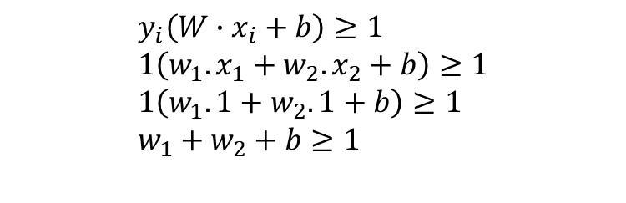
Example
x1 | x2 | Y
1 | 1 | 1
1 | -1 | -1
-1 | 1 | -1
-1 | -1 | -1
$$y_{i}\left(W∙x_{i}+b\right)≥1 \\ 1\left(w_{1}.x_{1}+w_{2}.x_{2}+b\right)≥1 \\ 1\left(w_{1}.1+w_{2}.1+b\right)≥1 \\ w_{1}+w_{2}+b≥1$$

Slide 22
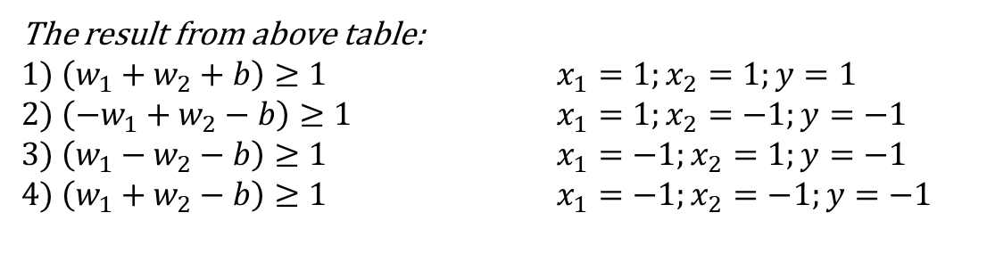
Example
x1 | x2 | Y
1 | 1 | 1
1 | -1 | -1
-1 | 1 | -1
-1 | -1 | -1
The result from above table:
$1) \left(w_{1}+w_{2}+b\right)≥1$ $x_{1}=1;x_{2}=1;y=1$ $2) \left({−w}_{1}+w_{2}−b\right)≥1$ $x_{1}=1;x_{2}=−1;y=−1$
$3) \left(w_{1}−w_{2}−b\right)≥1$ $x_{1}=−1;x_{2}=1;y=−1$
$4) \left(w_{1}+w_{2}−b\right)≥1$ $x_{1}=−1;x_{2}=−1;y=−1$

Slide 23

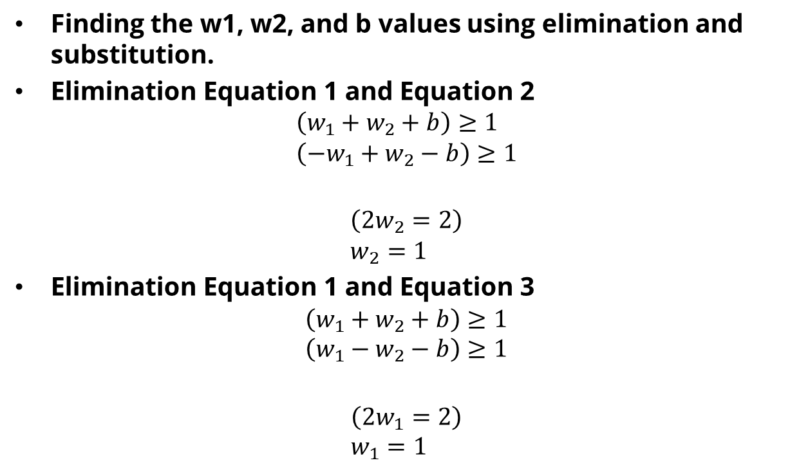

Example
Finding the w1, w2, and b values using elimination and substitution.
Elimination Equation 1 and Equation 2
$$\left(w_{1}+w_{2}+b\right)≥1 \\ \left({−w}_{1}+w_{2}−b\right)≥1$$ $$\left(2w_{2}=2\right) \\ w_{2}=1$$
Elimination Equation 1 and Equation 3
$$\left(w_{1}+w_{2}+b\right)≥1 \\ \left(w_{1}−w_{2}−b\right)≥1$$ $$\left(2w_{1}=2\right) \\ w_{1}=1$$
$$+$$
$$+$$

Slide 24

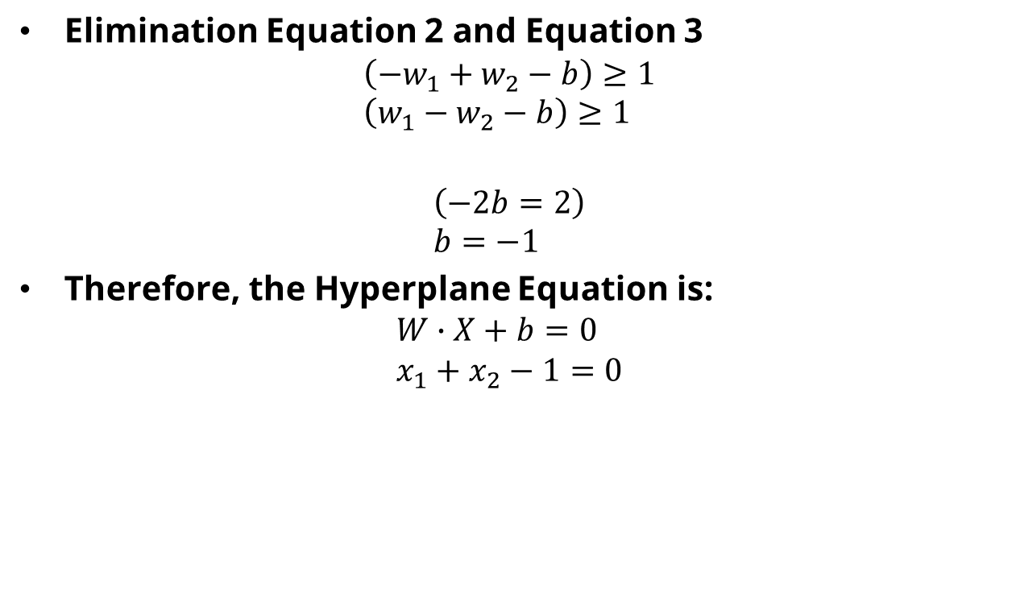
Example
Elimination Equation 2 and Equation 3
$$\left({−w}_{1}+w_{2}−b\right)≥1 \\ \left(w_{1}−w_{2}−b\right)≥1$$ $$\left(−2b=2\right) \\ b=−1$$
Therefore, the Hyperplane Equation is:
$$W∙X+b=0 \\ x_{1}+x_{2}−1=0$$
$$+$$

Slide 25
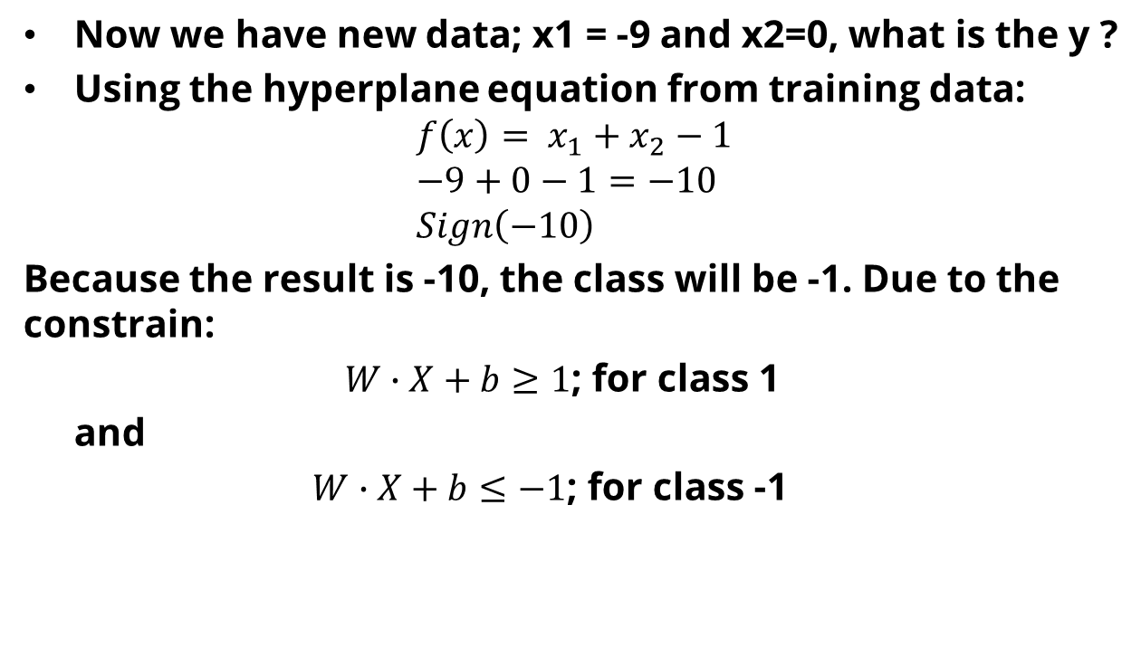
Example
Now we have new data; x1 = -9 and x2=0, what is the y ?
Using the hyperplane equation from training data:
$${f\left(x\right)= x}_{1}+x_{2}−1 \\ −9+0−1=−10 \\ Sign\left(−10\right)$$
Because the result is -10, the class will be -1. Due to the constrain:
$W∙X+b≥1$; for class 1
and
$W∙X+b≤−1$; for class -1

Slide 26
Exercise
x1 | x2 | Y
3 | 4 | 1
2 | 7 | 1
-5 | -2 | -1
-7 | -3 | -1
From above data training, find the hyperplane equation
Assume you have x1= 2, and x2=-1, Determine the class of this new data.

Slide 27
Reference
Siti Aminah, Dina Cahyati, Ari Wibisono, Dhimas Arief, Learning to Classify: the Support Vector Machines. Universitas Indonesia
Andrew Moore and Martin Law. 2022. Introduction to Support Vector Machines. https://cse.hkust.edu.hk/~qyang/221/Lectures/intro%20to%20svm%20221.ppt
https://www.cs.cornell.edu/courses/cs4780/2018fa/lectures/lecturenote09.html

